Slide 1
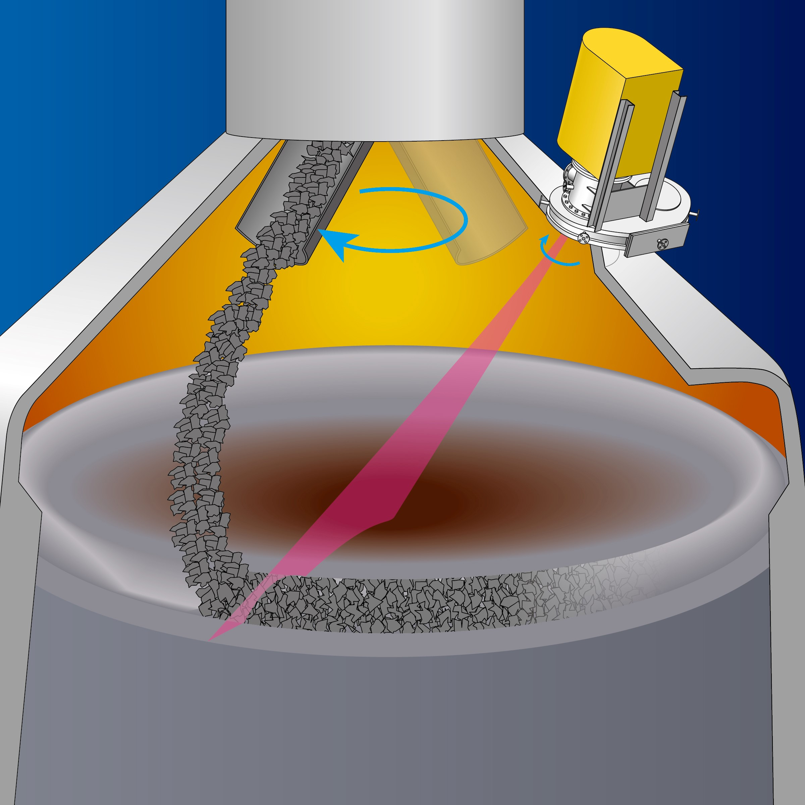
THE MWS-BF-3DV Blast Furnace Profile Meter
1. General
Field of view Full surface: Normal mode
Measurement taken while the feeding
chute is stopped.
Approx. 270°: High-speed mode
(following feeding chute
rotation)
The profilemeter is aligned with the
feeding chute’s rotation.
Measure time Normal mode: Approx. 20sec.
High-speed mode: Approx. 5sec.
Accuracy Approx. ±50mm (stockline surface)
Flange size 10K1000A (hole size: φ830mm)
System height Approx. 1,700mm
Weight System: Approx. 700kg
Sliding valve: (TBD)

Slide 2
THE MWS-BF-3DV Blast Furnace Profile Meter
2. Function
2.1. Measurement principle

Slide 3
THE MWS-BF-3DV Blast Furnace Profile Meter
2. Function
2.2. Normal mode measurement (feeding chute stopped), 20 seconds
A. Measurement (image)

Slide 4
THE MWS-BF-3DV Blast Furnace Profile Meter
2. Function
2.3. High-speed mode measurement (following feeding chute), 5 seconds
A. Measurement (image)

Slide 5
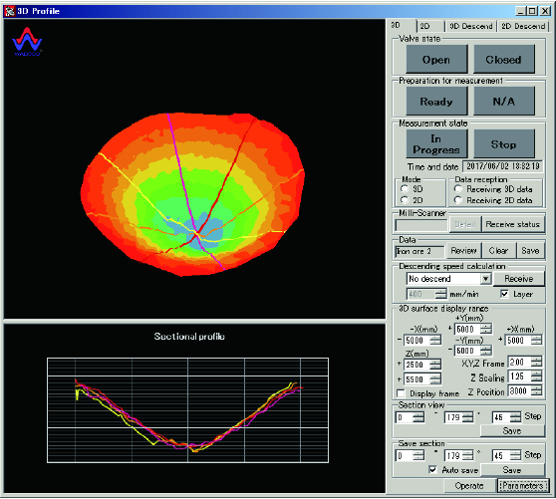
The MWS-BF-3DV Blast Furnace Profile Meter
3. Software Indication
3.1 Software for 3D profile indication with sectional display (Normal mode)

Slide 6
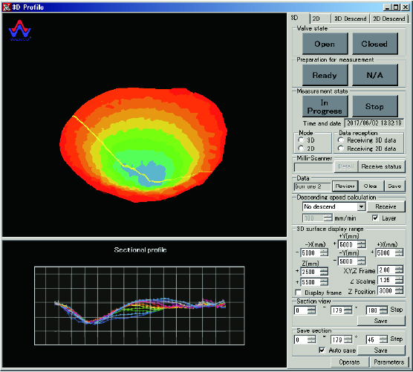
The MWS-BF-3DV Blast Furnace Profile Meter
3. Software Indication
3.2 Software for 3D profile indication with sectional display (High-speed mode)

Slide 7
THE MWS-BF-3DV Blast Furnace Profile Meter
4. Features
All problems associated with conventional lance measurement systems will be solved!
3D surface map and its profiles at selectable angles measured in 20 seconds and displayed for every batch.
Chute Tracking Function (Option)
Measure the profile continuously while charging by following the feeding chute and display a 3D surface map for each full rotation of the chute, allowing real-time control of the charge distribution. (option)
The descending speed can be measured and displayed for any angle of the 3D surface map.
Compact, simple design results in easy maintenance and there is almost no dust adhesion on the antenna.
Simple design results in saving of space and there is no concern of gas leaks.
With a sliding valve, the profile meter is separated from the inside of the blast furnace.
The system is installed outside of the furnace. Unaffected by the heat and pressure of the blast furnace, maintenance can be done easily.
Stable measurement even when the surface of the coke/iron ore is sloped.
Special filter for elimination of unwanted signals (chattering, obstructions inside the blast furnace).
The amount of build-up in the profilemeter can be measured by attenuation of the milliwaves from outside the furnace.
Water cooling is unnecessary.

